Slide 1

Notes:
Today you are going to meet my friends Maggie and Andy. Are you ready to meet them? OK lets meet my friend Maggie first!

Slide 2
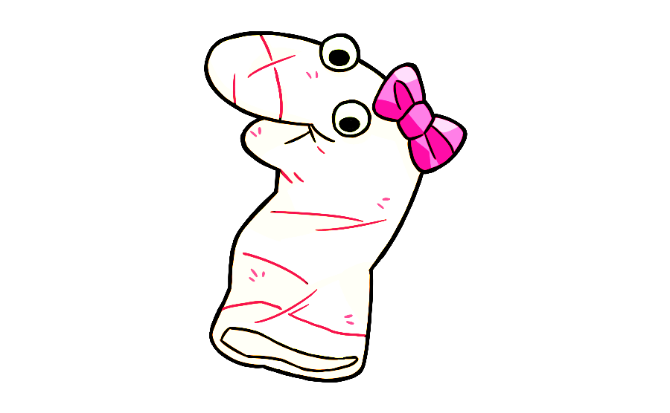
Notes:
This is Maggie! Say high to Maggie. Hi Maggie [wiggle]. Today you and Maggie are going to meet Andy and learn about Andy’s projects. Let’s meet Andy!

Slide 3

Notes:
This is Andy! Say hi to Andy. Hi Andy [wiggle]! Andy has lots of supplies for his projects. And he wants to show them to you and Maggie! Let’s see his supplies!

Slide 4


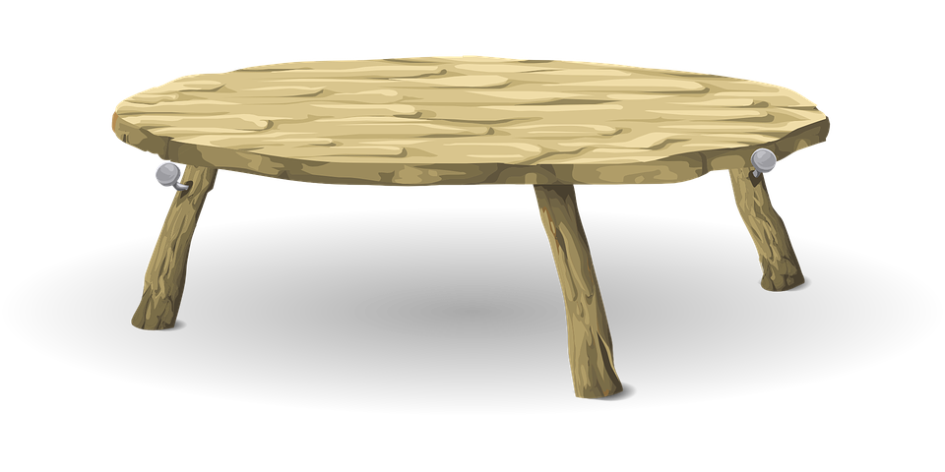

Notes:
Look at all of the supplies that Andy has for his projects! He has crayons, paper and even tools and a toolbox! For his first project, Andy wants to change something with his supplies. Let’s see what Andy will use for his project.

Slide 5
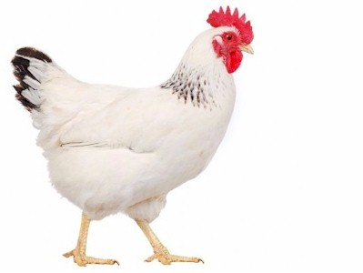
Notes:
This is what Andy will use for his project [wiggle]! Maggie says, that’s a chicken! And chickens are for laying eggs! OK so Andy takes the chicken and uses his supplies to change it. He took away its feathers and gave it two more legs and a tail. After the changes it looked like….

Slide 6
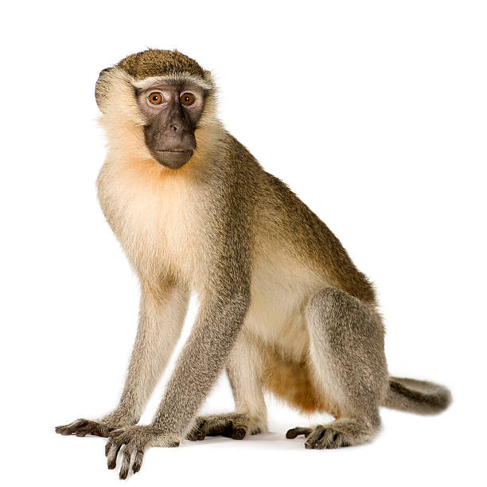
Notes:
This! Maggie says, that looks like a monkey! And monkeys are for swinging from trees! Then Andy [wiggle] says to Maggie, “This isn’t for swinging from trees.” It is only for laying eggs!” Okay, so the thing that Andy changed looks like [wiggle] this, but it is only for laying eggs. So, what do you think it is? Is this a chicken or a monkey?

Slide 7

Notes:
Thanks! Lets see the next project Andy will work on!

Slide 8
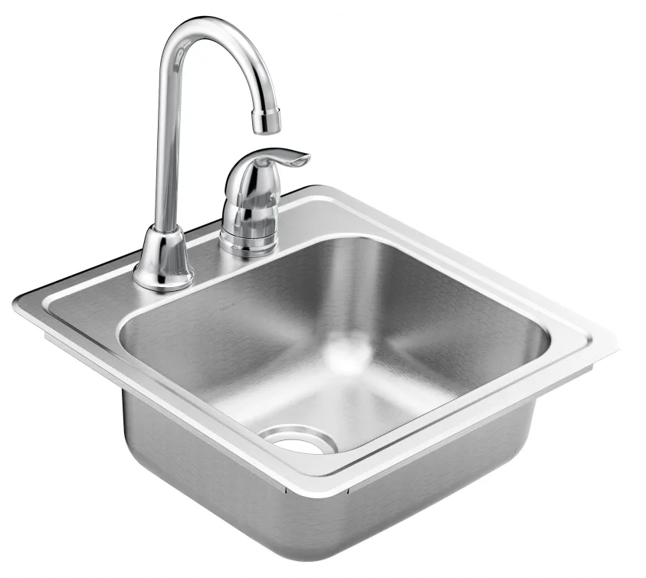
Notes:
This is what Andy will use for his project [wiggle]! Maggie says, that’s a sink! And sinks are for washing your hands! OK so Andy takes the sink and uses his supplies to change it. He made it rounder and added a handle and lid to it. After the changes it looks like….

Slide 9
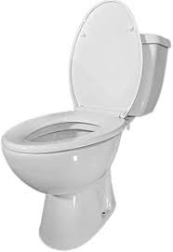
Notes:
This! Maggie says, that looks like a toilet! And toilets are for going to the bathroom! Then Andy [wiggle] says to Maggie, ”This isn’t for going to the bathroom”. It’s only for washing your hands! Ok so the thing Andy changed looks like [wiggle] this but it’s only for washing your hands. So what do you think it is? Is it a sink or a toilet?

Slide 10
Notes:
Thanks! Lets see the next project Andy will work on!

Slide 11
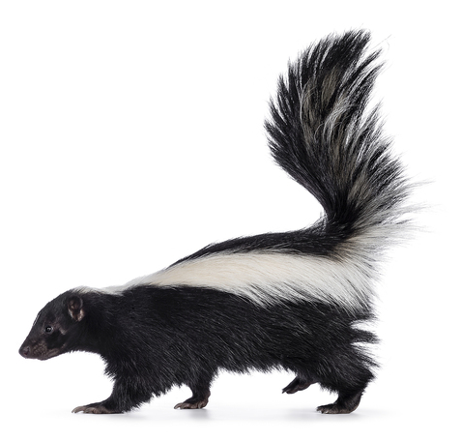
Notes:
This is what Andy will use for his project [wiggle]! Maggie says, “That’s a skunk! And skunks are for smelling stinky!” Ok, so Andy takes the skunk and uses his supplies to change it. He colored the fur brown and gave it pointy ears. After the changes it looks like...

Slide 12
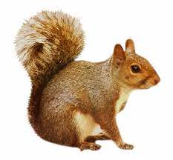
Notes:
This! Maggie says, “That looks like a squirrel! And squirrels are for eating nuts!” Then Andy [wiggle] says to Maggie, “This isn’t for eating nuts! It is only for smelling stinky!” Ok, so the thing Andy changed looks like [wiggle] this but it is only for smelling stinky! So, what do you think it is? Is it a skunk or a squirrel?

Slide 13
Notes:
Thanks! Lets see the next project Andy will work on!

Slide 14
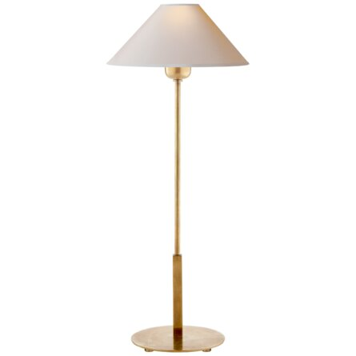
Notes:
This is what Andy will use for his project [wiggle]! Maggie says, ”That’s a lamp! And lamps are for providing light!” Ok, so Andy takes the lamp and uses his supplies to change it. He added a handle and made the top wider. After the changes it looks like...

Slide 15
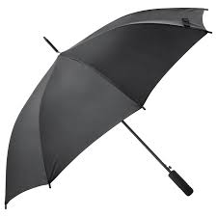
Notes:
This! Maggie says, “That looks like an umbrella! And umbrellas are for protecting you from the rain!” Then Andy [wiggles] says to Maggie, ”This isn’t for protecting you from the rain. It is only for providing light!” Ok, so the thing Andy changed looks like [wiggle] this but it is only for providing light. So, what do you think it is? Is it a lamp or an umbrella?

Slide 16
You are halfway done! Thank you so much for all the answers so far. Let’s see what Andy will work on next!

Slide 17
Notes:
Thanks! Lets see the next project Andy will work on!

Slide 18
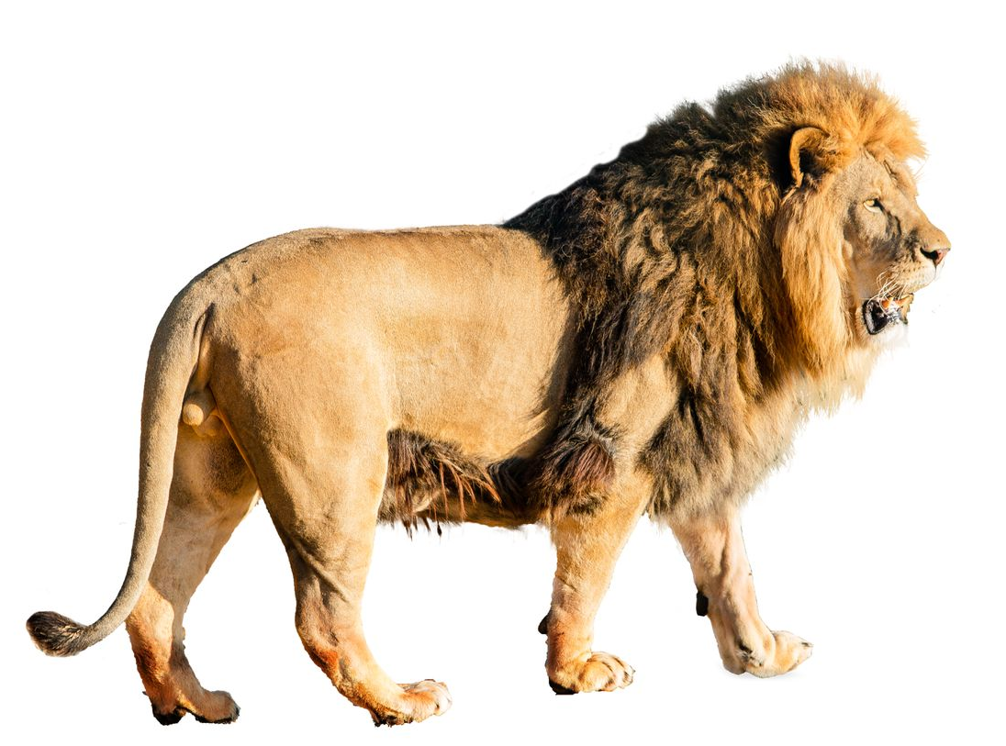
Notes:
This is what Andy will use for his project [wiggle]! Maggie says, “That’s a lion! And lions are for roaring!” Ok, so Andy takes the lion and uses his supplies to change it. He put spots on it and gave it hooves. After the changes it looks like...

Slide 19
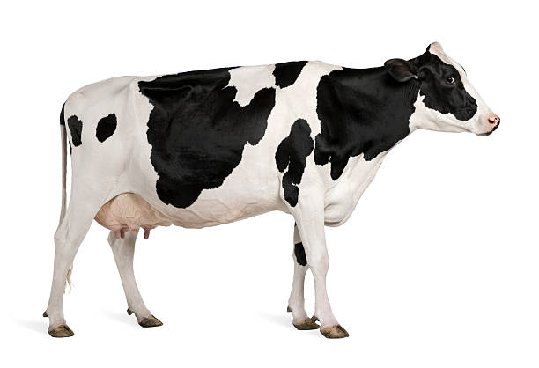
Notes:
This! Maggie says, “That looks like a cow! And cows are for making milk!” Then Andy [wiggle] says to Maggie, “This isn’t for making milk! It is only for roaring!” Ok, so the thing that Andy changed looks like [wiggle] this but it is only for roaring. So, what do you think it is? Is this a lion or a cow

Slide 20
Notes:
Thanks! Lets see the next project Andy will work on!

Slide 21
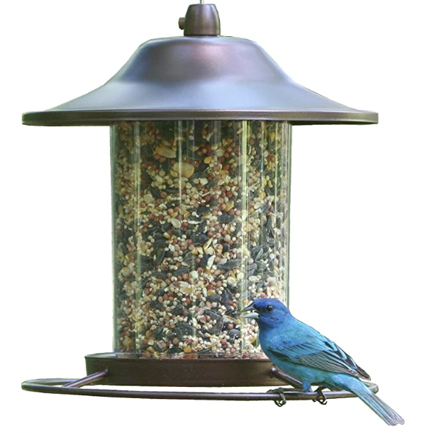
Notes:
This is what Andy will use for his project [wiggle]! Maggie says, that’s a birdfeeder! And birdfeeders are for feeding birds! OK so Andy takes the birdfeeder and uses his supplies to change it. He flattened it some and made it wider. He also added a handle to it. After the changes it looked like….

Slide 22
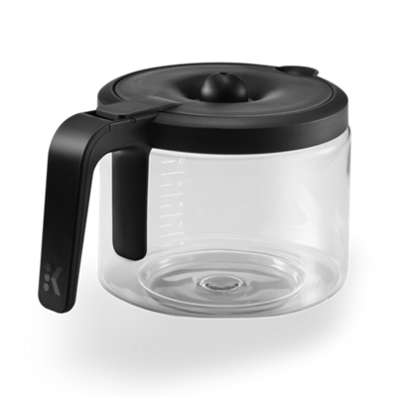
Notes:
This! Maggie says, that looks like a coffee pot! And coffee pots are for holding coffee! Then Andy [wiggle] says to Maggie, ”This isn’t for holding coffee!”. It is only for feeding birds! Ok so the thing Andy changed looks like [wiggle] this but it is only for feeding birds. So what do you think it is? Is it a bird feeder or a coffee pot.

Slide 23
Notes:
Thanks! Lets see the next project Andy will work on!

Slide 24
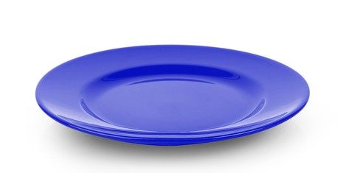
Notes:
This is what Andy will use for his project [wiggle] ! Maggie says, that’s a plate! And plates are for eating on! OK so Andy takes the plate and uses his supplies to change it. He flattened it and then painted numbers on it and added hands. After the changes it looked like….

Slide 25

Notes:
This! Maggie says, that looks like a clock! And clocks are for telling time! Then Andy [wiggle] says to Maggie, ”This isn’t for telling time!”. It’s only for eating on! Ok so the thing Andy changed looks like [wiggle] this but it is only for eating on. So what do you think it is? Is it a plate or a clock?

Slide 26
Notes:
Thanks! Lets see the next project Andy will work on!

Slide 27
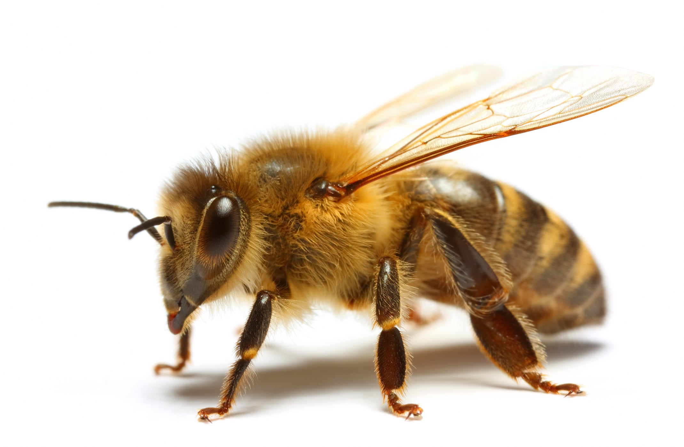
Notes:
This is what Andy will use for his project [wiggle]! Maggie says, that’s a bee! And bees are for making honey! OK so Andy takes the bee and uses his supplies to change it. He removed its wings and antennae, lengthen its legs and added a new pair of legs. After the changes it looked like….

Slide 28
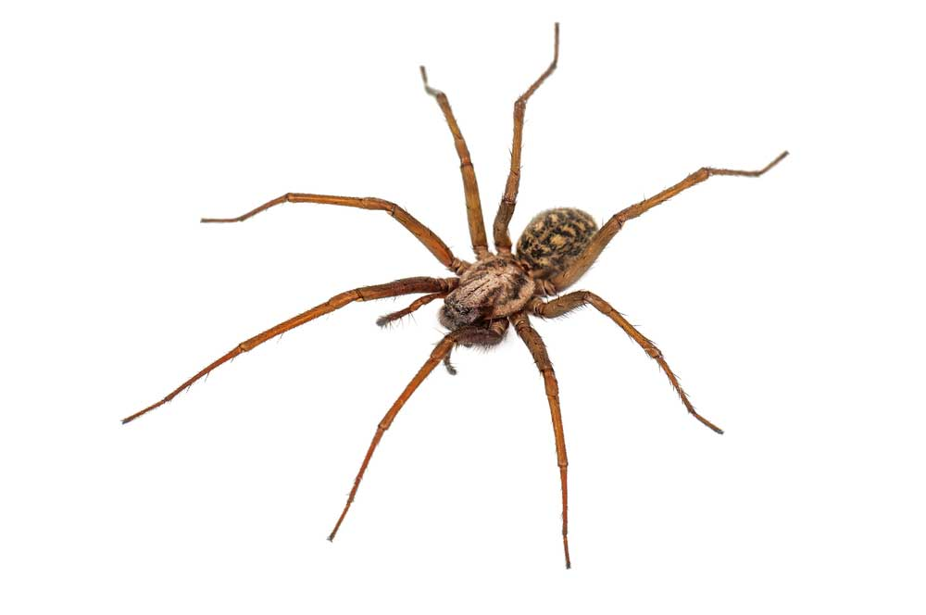
Notes:
This! Maggie says, that looks like a spider! And spiders are for making webs! Then Andy [wiggle] says to Maggie, ”This isn’t for making webs!”. It is only for making honey! Ok so the thing Andy changed looks like [wiggle] this but it is only for making honey. So what do you think it is? Is it a bee or a spider?

Slide 29
Notes:
Thanks! Lets see the next project Andy will work on!

